Slide 1

NCR 4331
BID 141KM SF300065C002.2X - Zeta wires unlocking

Slide 2
Pipe section / details
Item | Traceability / identification
Project number | 300065C004
Project name | BID 141KM
Pipe section | SF300065C004.2X
ST number | ST101.51896
Affected layer / equipment | Zeta Wire
Length affected | 1602.2m
Drawing number / MP code / STA / Dimension | ZETA 6.2 FI09 (MP205)

Slide 3
Overview of anomaly
Problem Description:-
During the zeta spiraling of BID 141KM SF300065C004.2X (ST101.51896), the zeta unlock was detected at length 1602.2m
Root Cause:-
The root cause was due to uneven brake adjustment.
Problem Handling:-
Reparation by un-spiral has been performed to re-position the wires to be in a good spiral. Thus, this reparation was accepted as it is and the dimensional after the repair is within the criteria.

Slide 4
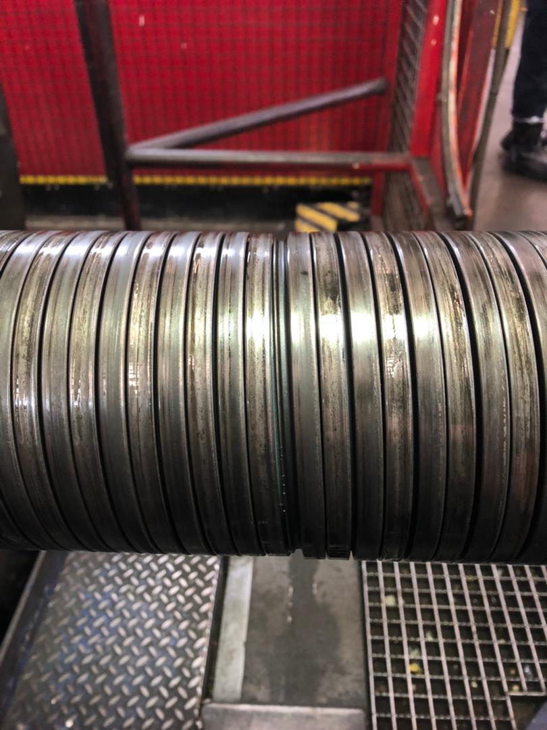
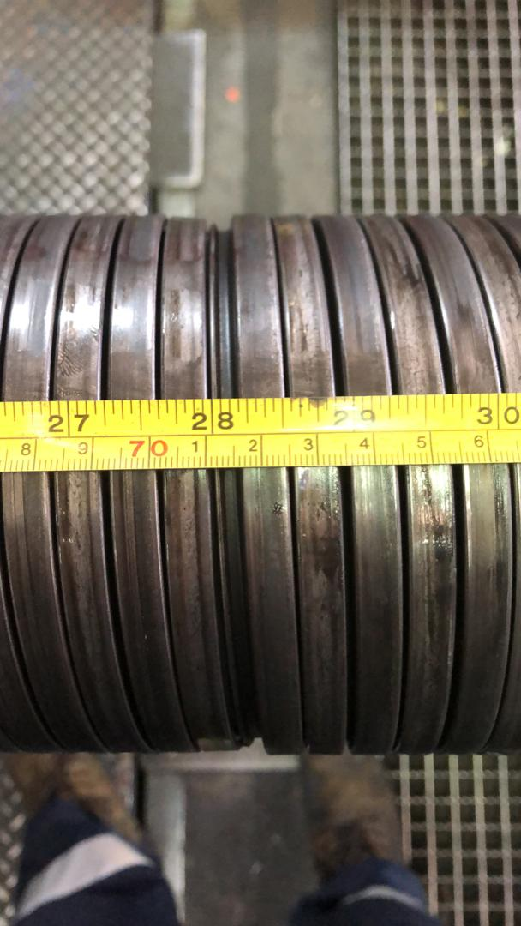
Overview Of Anomaly
Figure 1 : Condition of the defect

Slide 5
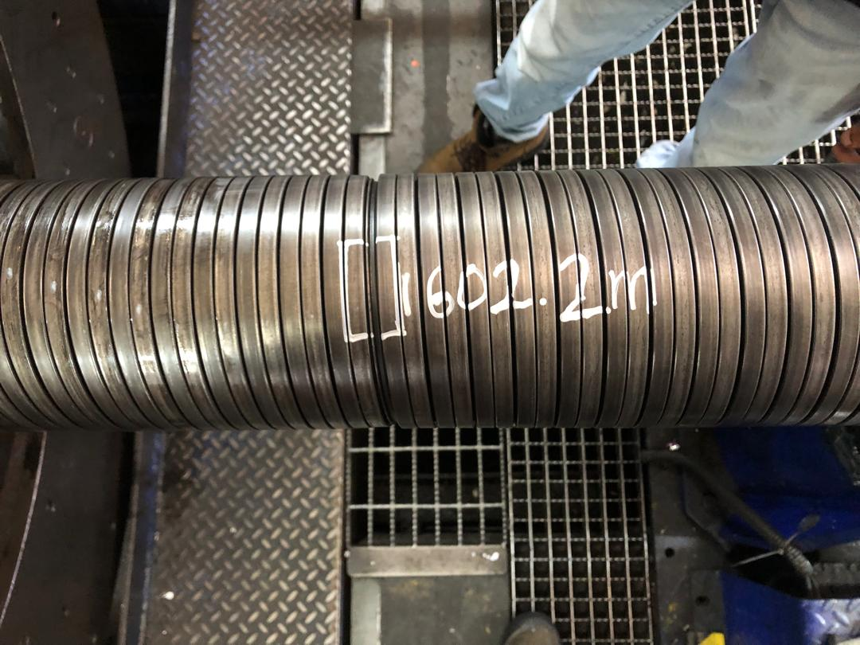
Length of Defect
Figure 2 : The zeta unlock was detected at length 1602.2m

Slide 6
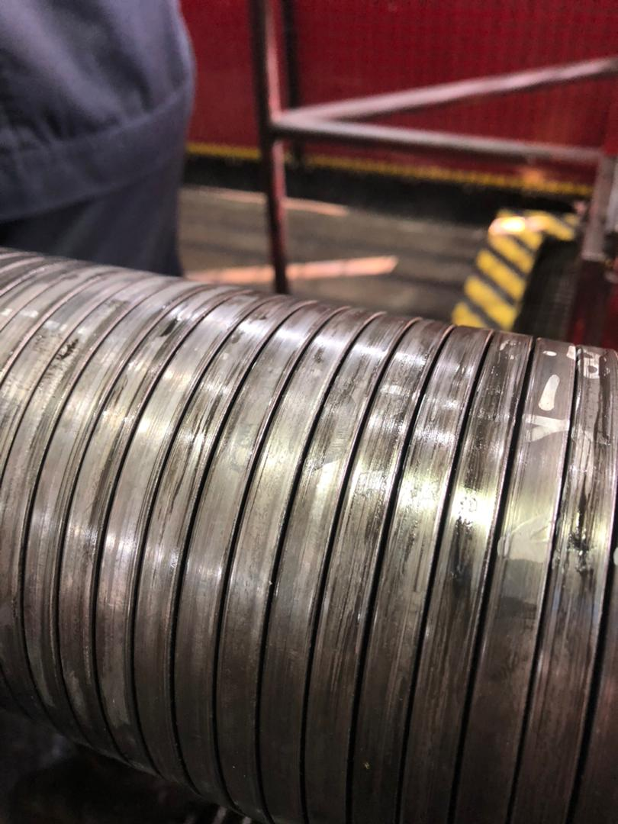
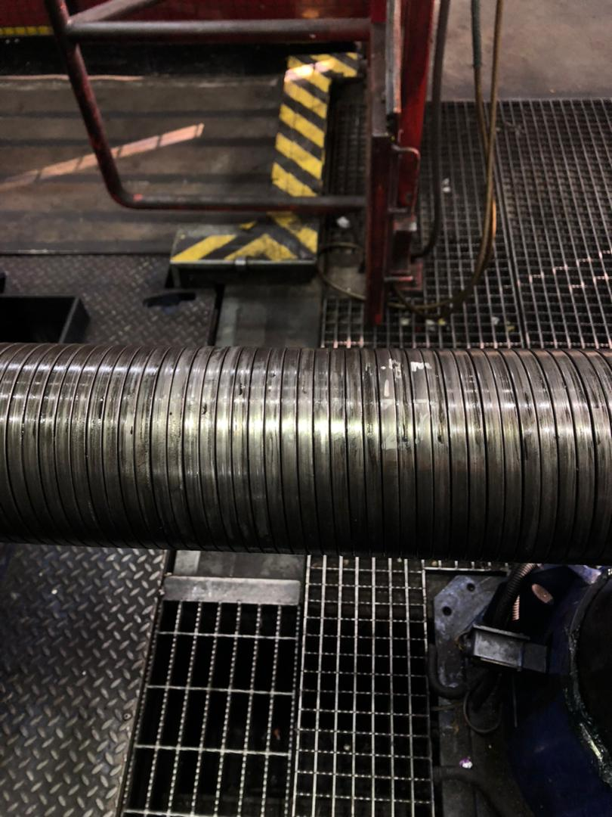
After Repaired
Figure 3 : Condition of wire after repaired

Slide 7

THANK YOU

